Slide 1
Towards JIT compiler for IO language Dynamic mixin optimization
Salikh Zakirov, Shigeru Chiba and Etsuya Shibayama
Tokyo Institute of Technology
Dept. of Mathematical and Computing Sciences
2010-09-13

Slide 2
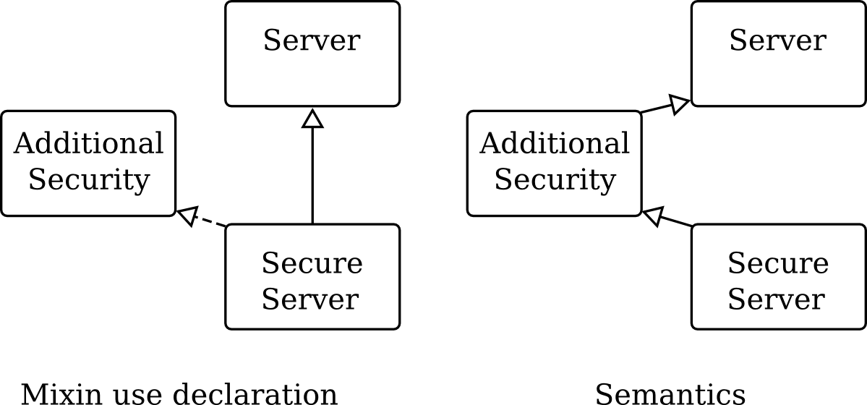
Introduction: Mixin
code composition technique

Slide 3
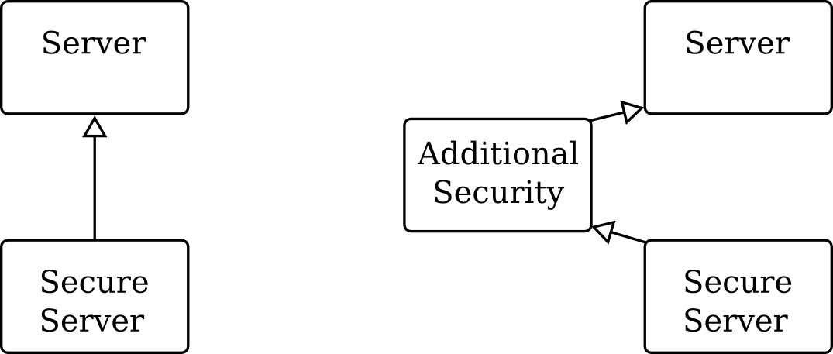
Introduction: Dynamic mixin
Temporary change in class hierarchy
Available in Ruby, Python, JavaScript

Slide 4
Dynamic mixin applications
Load-time composition
e.g. Rack – Ruby HTTP server infrastructure
Programming paradigms
Context-oriented programming
Dynamic aspect-oriented programming
Temporary override
Our example
install AdditionalSecurity on some requests

Slide 5
Dynamic mixin issues
Implementation inefficient
Frequent mixin install/remove operations cause high overhead
Root cause analysis for Ruby interpreter
Coarse-grained cache invalidation
Single inline cache entry

Slide 6
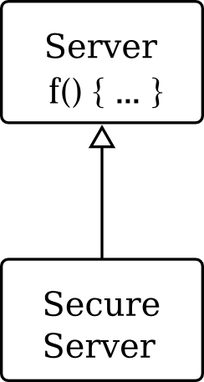
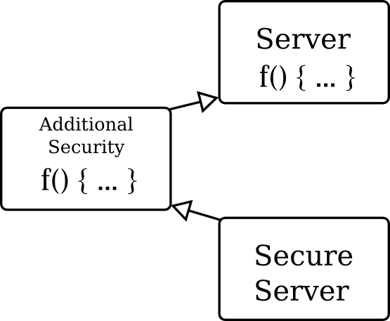
Idea: efficient dynamic mixin
Control flow graph of compiled call site
server.f()
Repeated dynamic mixin
install / removal
f₁
f₁
if (s == 1)
State guard
f₁
s = 1
s = 2
if (s == 2)
Inlined
method
f₁
f₂
handle
inline cache
miss
f₂
continue

Slide 7
Proposal: Dynamic mixin optimizations
Fine-grained state tracking
Polymorphic inline caching
Multi-version inlining
Alternate caching

Slide 8
Our preceding work
We implemented the dynamic mixin optimization for Ruby 1.9.1 interpreter ¹
6x times faster in the best case
… but not so efficient in normal cases
Inline cache miss is only 60% slower than inline cache hit
Compiled world is different…
Hit vs. miss performance gap is larger than in interpreter
¹ “Optimizing dynamic dispatch with fine-grained state tracking”,
to appear in proceedings of DLS’10

Slide 9
Contents of this work
We implement a small dynamic compilation system
We evaluate performance characteristics of dynamic mixin optimizations

Slide 10
Target language: IO
Pure object-oriented
Prototype-based
With minimal syntax
Has both call-by-name and call-by-value
Metaprogramming via AST manipulations

Slide 11
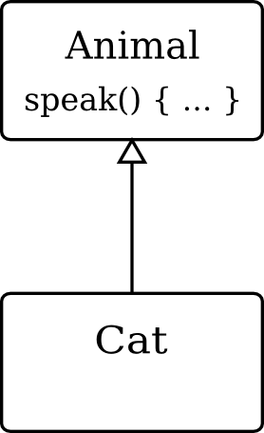
Basics: inline caching
Consider a call site:
cat.speak();
Dynamic dispatch
Cat_speak
Cat_speak
Animal_speak
With inline caching
method = lookup(cat, ”speak”);
method(cat);
if (cat is Cat) {
Animal_speak(cat);
} else {
method = lookup(cat, ”speak”);
method(cat);
}
Expensive!
What if speak() has been redefined?

Slide 12
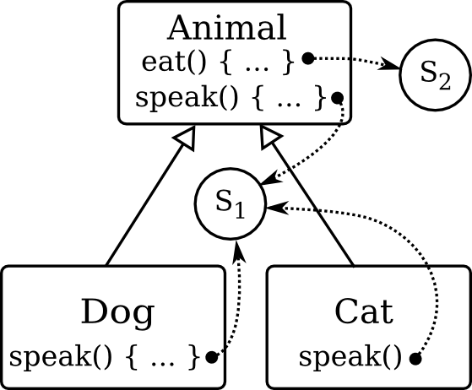
Fine-grained state tracking
A state object for each method family
contains an integer counter
Linked from method tables
links updated during method lookups
Invariant
Any change that may affect method dispatch must also trigger change of associated state object

Slide 13
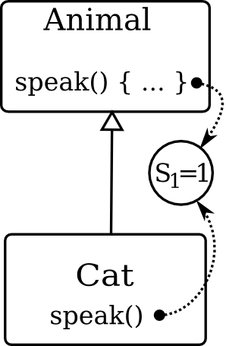
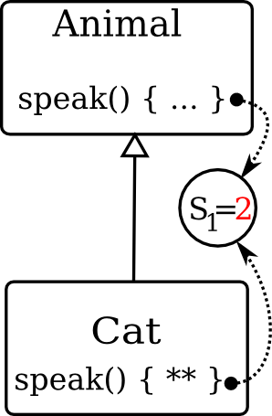
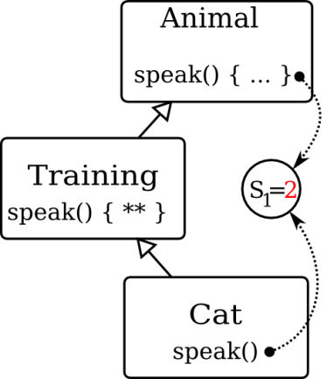
Cache invalidation
A call site:
obj.speak();
Cat_speak
Cat_speak
Animal_speak()
With invalidation:
method
redefined
if (obj is Cat && s₁ == 1) {
Animal_speak(obj);
} else {
method = lookup(obj, ”speak”);
method(obj);
}
speak()
override
mixin
installed
speak()
override

Slide 14
Polymorphic inline caching
1 state object per call site
multiple state values, types and targets
if (obj is Cat && s == 1)
State guards
Method call
or
inlined code
if (obj is Dog && s == 2)
f₁
handle
inline cache
miss
f₂
continue

Slide 15
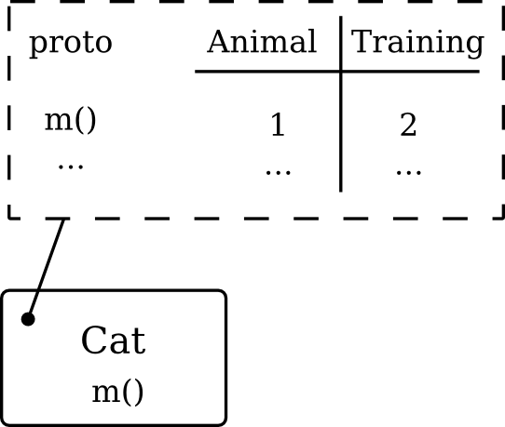
Alternate cache
Two snapshots of method table
State value swapped
conflicting updates detected by state value check
Alternate cache

Slide 16
Overheads of proposed scheme
Increased memory use
1 state object per polymorphic method family
additional method entries
alternate cache
polymorphic inline cache entries
code size increase due to inlining
Some operations become slower
Lookup needs to track and update state objects
Explicit state object checks on method dispatch

Slide 17
Evaluation (work-in-progress)
Goals
Verify effectiveness
Evaluate overheads
IO implementation is only partially complete
Only call-by-value methods
Integer arithmetic
while(), if()
Hardware: Intel Core i7 860 (x86_64), 2.8 GHz

Slide 18
Compiler design
Method call resolved using inline cache records
Inline cache is primed by interpreter
Type guards
Fall back to interpreter on guard failure
No guard duplication where value type is known
LLVM 2.5 as a back-end

Slide 19
Microbenchmark
Object and mixin definitions
x := Object clone; x g := method(x, x+x )
m := x clone; m g := method(x, x*x )
y := x clone
f := method(n,y,
i := 0
s := 0
while (i < n,
s := s + y g(i)
if (i % 2 == 0,
on
,
off)
i := i+1)
s))
Dynamic dispatch in each iteration
Install or remove mixin on each iteration

Slide 20
Preliminary experimental results
(smaller is better)
Microbenchmark run time, ms
Overhead of fine-grained
state tracking is about 18%
Alternate caching improves performance by 2.75 times

Slide 21
Related work
Self
Fine-grained dependency and invalidation infrastructure
Type-split compilation
Polymorphic inline caching
Tracemonkey
Trace-based just-in-time specialization
Dynamic mixin optimization is not tackled

Slide 22
Conclusion
We proposed dynamic mixin optimization by
Fine-grained state tracking
Polymorphic inline caching
Alternate caching
We experimentally verified that
Dynamic mixin optimization is effective
Ongoing work
Evaluate associated overheads
Evaluate efficiency on a realistic system

Slide 23
Thank you for your attention

